Slide 1
Human Resource Analytics

Slide 2


MEET OUR TEAM
SHARAD NATHWANI
VENKATESH GANGJI
RITIKA SINGH
AISHWARYA SINGH
RAJARAM SHETTY
DNYANESHWAR SHINDE
VAISHNAVI DHEMBARE

Slide 3
TABLE OF CONTENTS
OBJECTIVES & PROJECT TIMELINE
DATA CLEANING PROCESS
1
2
DASHBOARDS
MYSQL QUERIES
3
4
CHALLENGES & RESOLUTIONS
CONCLUSION & RECOMMENDATIONS
5
6

Slide 4
1
OBJECTIVES & PROJECT TIMELINE

Slide 5
1. ANALYSING HISTORICAL AND CURRENT ATTRITION TRENDS
2. IDENTIFY ROOT CAUSES OF ATTRITION
3. DEVELOP INTERACTIVE ATTRITION REPORTING DASHBOARD
4. FORMULATE TARGETED EMPLOYEE RETENTION STRATEGIES
Conduct an in-depth analysis of employee turnover data over time to identify patterns and trends.
Segment the data by relevant factors such as department, job role, demographics, and tenure to gain a granular understanding of attrition across the organization.
Investigate the underlying drivers of employee turnover through data collected from engagement surveys, exit interviews, and other relevant sources.
Analyse potential factors including compensation, work-life balance, career growth opportunities, management quality, and workplace culture.
Design and implement a user-friendly dashboard to visualize key attrition metrics and enable interactive exploration of the data.
The dashboard should display critical insights such as attrition rate by department, job role, work-life balance, and average tenure by department.
Based on the findings from the attrition analysis, develop and execute tailored strategies to improve employee retention.
Strategies may include competitive compensation packages, robust professional development programs, enhanced work-life balance initiatives, and improved management training.

Slide 6
PROJECT TIMELINE
WEEK 1
Excel Dashboard & MySQL
WEEK 2
Power BI
WEEK 3
Tableau
WEEK 4
Final Review Meeting

Slide 7
2
DATA CLEANING PROCESS

Slide 8
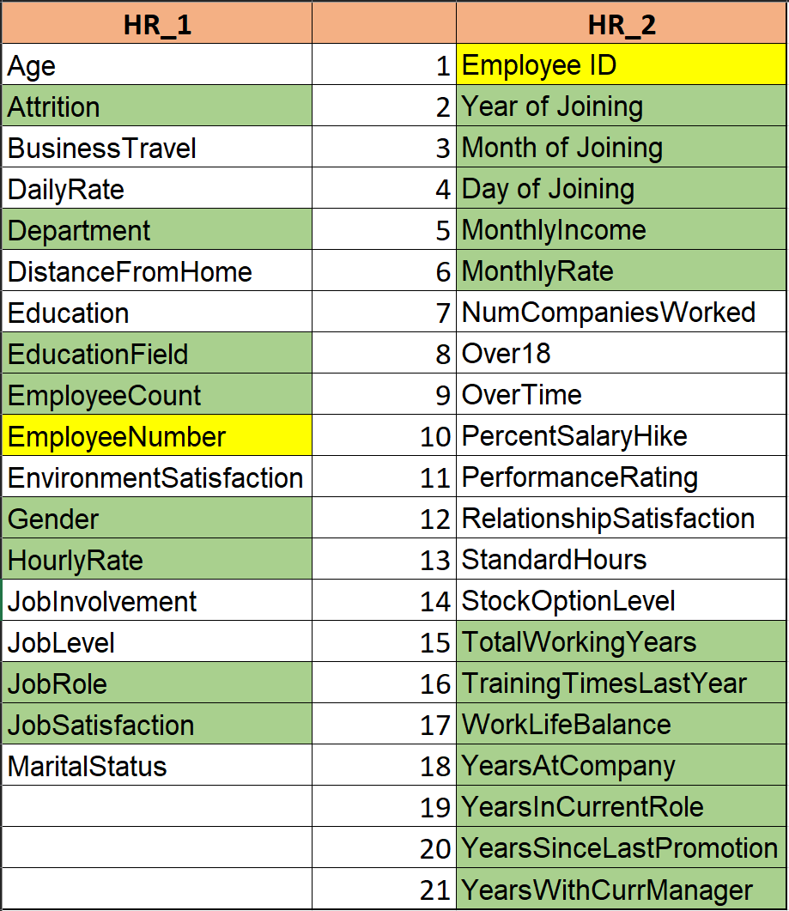
DATA HARMONIZATION
TARGETED COLUMN SELECTION
1
We identified columns containing common data points across both tables. These columns serve as the join keys, enabling the creation of a unified dataset through a merge operation.
2
We performed a critical analysis to identify the specific columns containing data essential for calculating the Key Performance Indicators (KPIs) required for the analysis. Only these relevant columns were chosen for inclusion in the final dataset, ensuring focus and efficiency.

Slide 9
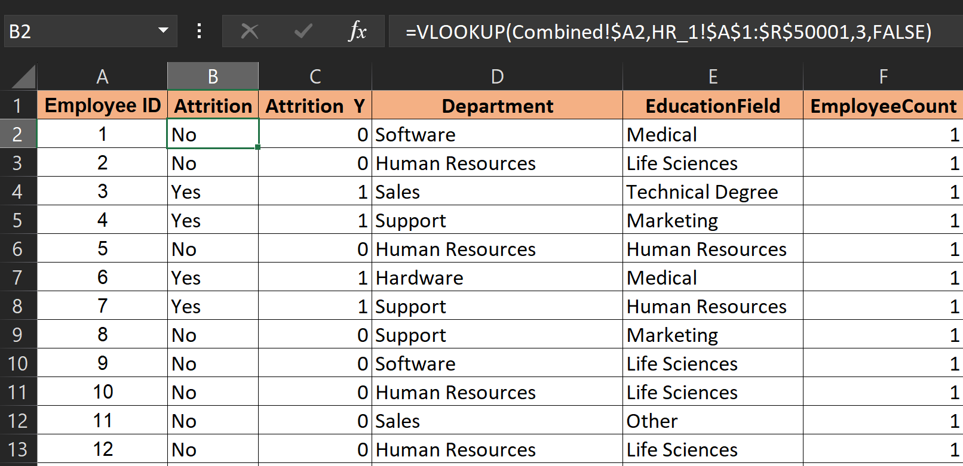
ELIMINATING DATA REDUNDANCY
LEVERAGING VLOOKUP FOR TARGETED DATA INTEGRATION
ENFORCING DATA TYPE CONSISTENCY
CUSTOMIZING DATA FORMATTING
4
3
We identified and removed duplicate entries within the final dataset. Duplicate data can distort analysis outcomes, hence its removal is crucial for maintaining data integrity.
To incorporate the chosen columns from the source table(s) into the final dataset, we employed the VLOOKUP function. This function excels at efficiently retrieving specific data points based on a defined lookup value (join key) and column index.
5
We ensured all columns within the final dataset adhere to the appropriate data type (e.g., numbers, dates, text). Data type consistency facilitates accurate calculations and analysis.
6
We meticulously formatted specific columns (e.g. dates) to a user-defined format (e.g. YYYY-MM-DD). This standardized format enhances data readability, facilitates sorting/filtering, and ensures compatibility with various data analysis tools.

Slide 10
3
DASHBOARDS

Slide 11
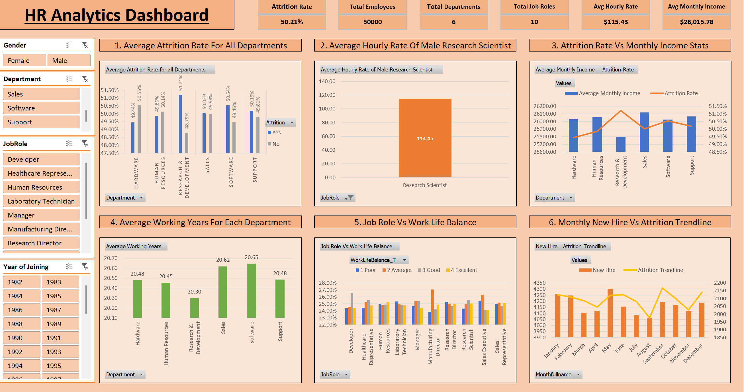
EXCEL DASHBOARD

Slide 12
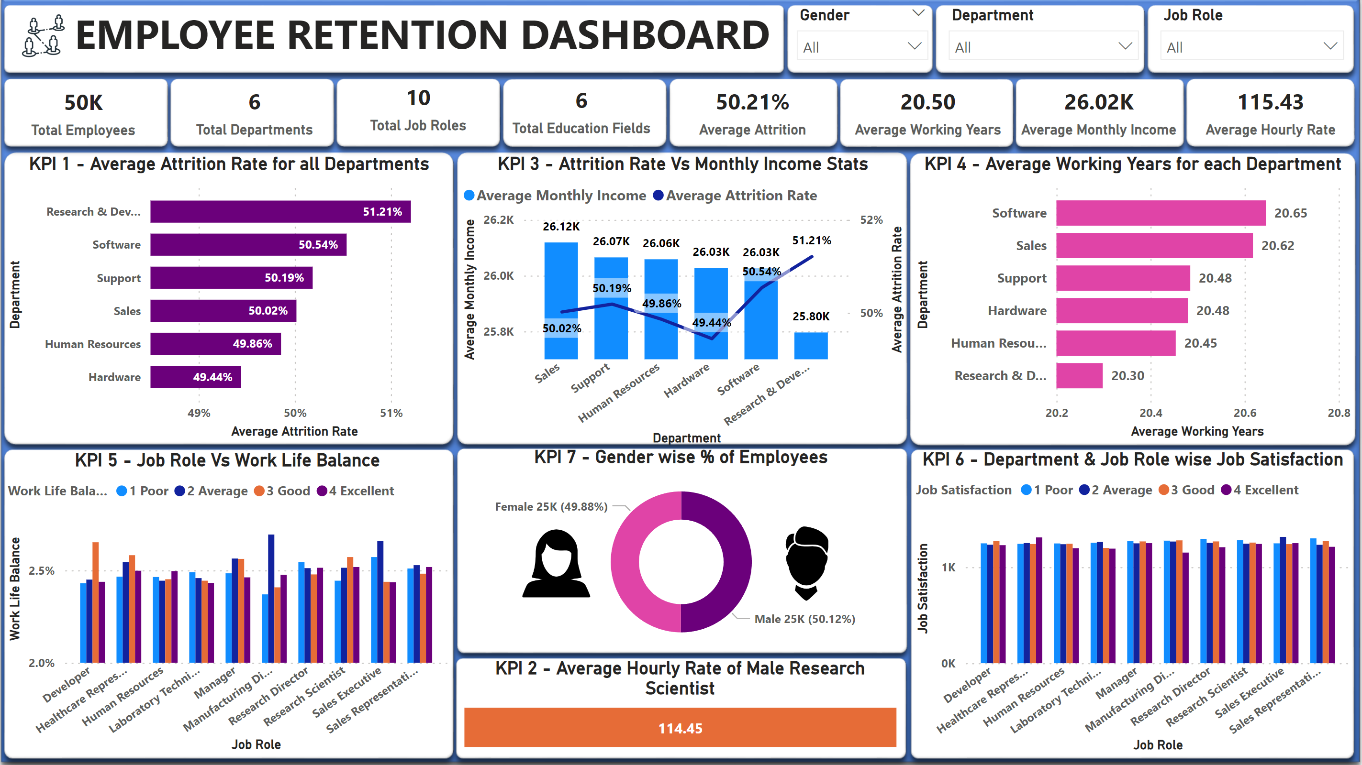
POWER BI DASHBOARD

Slide 13
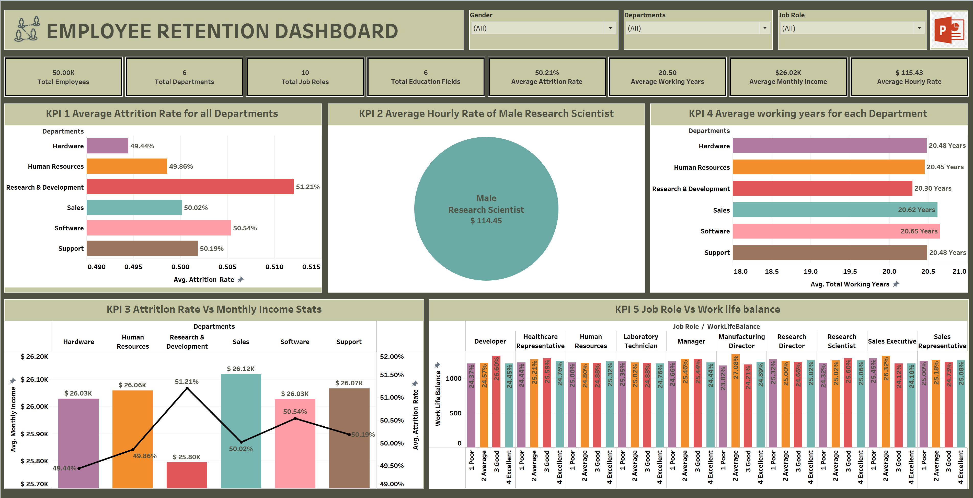
TABLEAU DASHBOARD

Slide 14
4
MYSQL QUERIES

Slide 15
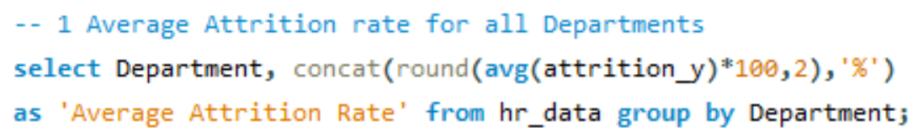
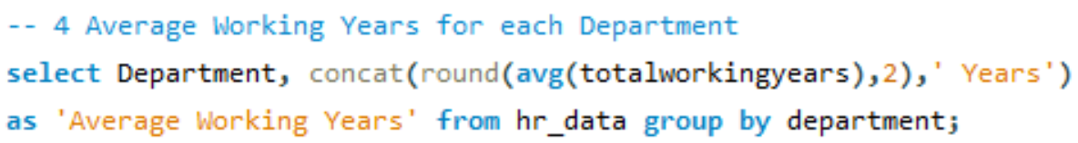
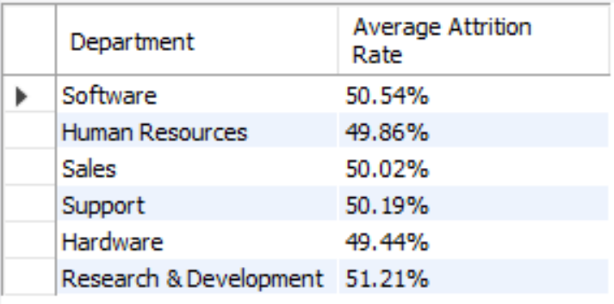
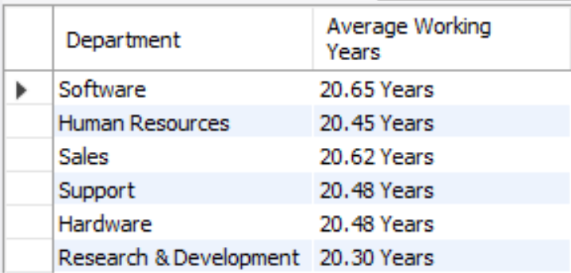
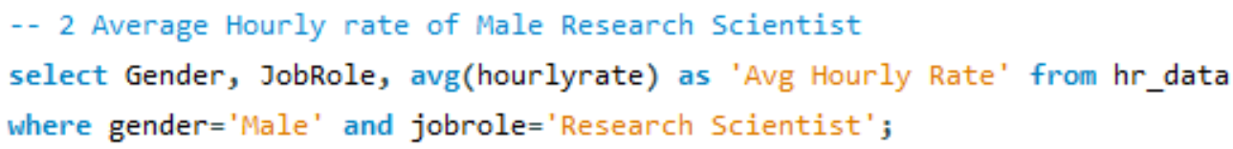
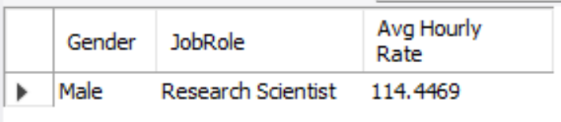
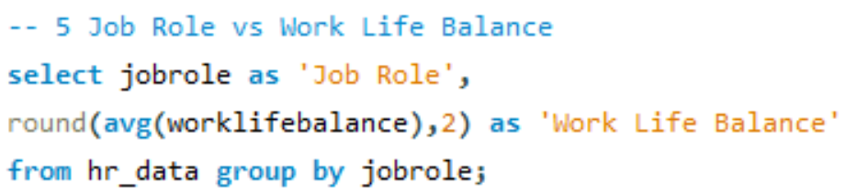
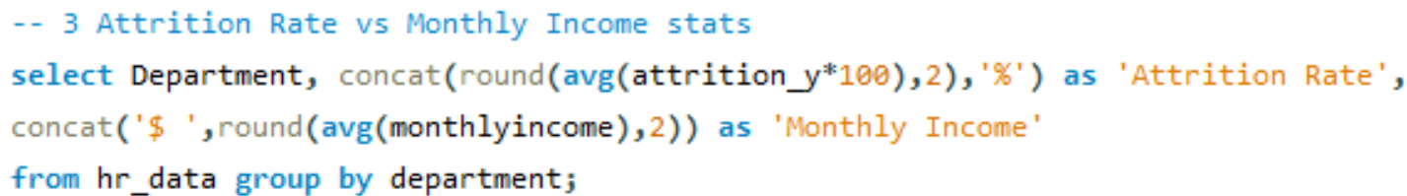
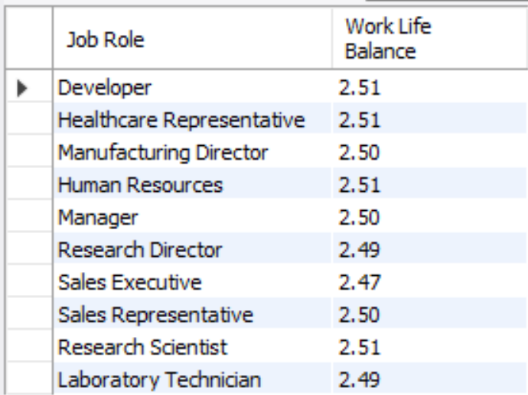
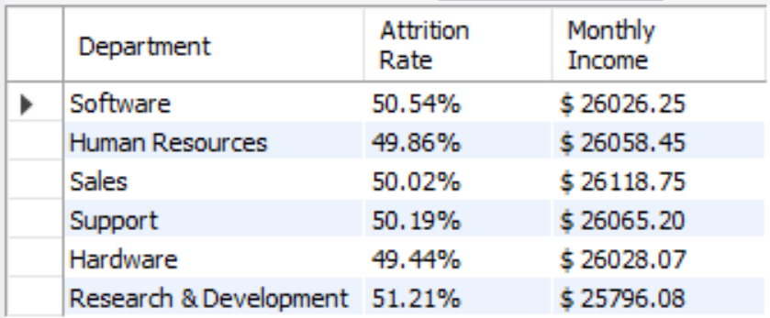
KPI 1
KPI 4
KPI 2
KPI 5
KPI 3

Slide 16
5
CHALLENGES & RESOLUTIONS

Slide 17
Challenge: We received two datasheets, HR1 and HR2, and using joins in Power BI, Tableau, and MySQL would have complicated the process and queries. Resolution: We cleaned the datasets and created a combined file with only the necessary columns for the KPIs using the VLOOKUP function. This streamlined the import process and saved significant time and effort.
Challenge: After data cleaning, while working on KPI 1 in Excel, we were unable to find the average attrition rate. Resolution: We added an extra column where "Yes" was considered 1 and "No" was considered 0, enabling us to calculate the average attrition rate.
Challenge: Excel Slicers were not working properly as some KPI sheets were not visible under the Report Connection option. Resolution: We made copies of the sheets that were visible under the Report Connection option, which allowed the slicers to function correctly for those particular KPIs.
Challenge: Visual alignment in all dashboards was difficult to achieve. Resolution: We adjusted the sizes of the KPIs that required less space to improve visual alignment.
Challenge: Data labels were not clearly visible in the dashboard. Resolution: We adjusted the visualization size and font size according to the number of labels in each visual to improve clarity.

Slide 18
6
CONCLUSION & RECOMMENDATIONS

Slide 19
The analysis of employee departures reveals a confluence of factors contributing to the high attrition rate of 50%. These factors include compensation (monetary), opportunities for growth, work-life balance, and overall job satisfaction. A concerning trend is the disproportionate number of highly experienced employees (over 20 years) leaving the company.
To address these issues and retain talent, the company should consider a multi-pronged approach:
Competitive Compensation and Benefits:
Review and adjust salaries and benefits packages to ensure they are competitive within the industry. This may involve targeted adjustments for senior employees with specialized skills and experience.
Professional Development:
Implement clear career pathing programs and provide opportunities for ongoing learning and development. This can include mentorship programs, skills training, and tuition reimbursement.

Slide 20
Work-Life Balance Initiatives:
Prioritize work-life balance by offering flexible work arrangements, remote work options, and promoting healthy boundaries between work and personal life.
Employee Recognition:
Develop a culture of appreciation by recognizing and rewarding employee achievements. This can be through public recognition, bonus structures, or tailored incentives.
Addressing Senior Employee Needs:
Specifically address the concerns of senior employees. This may involve creating opportunities for knowledge transfer, mentoring younger colleagues, or phased retirement plans.
By implementing these recommendations, the company can foster a more engaging and rewarding work environment, leading to increased employee retention, particularly among its most experienced and valuable talent pool.

Slide 21
THANK YOU!
ANY QUESTIONS?

